Slide 1
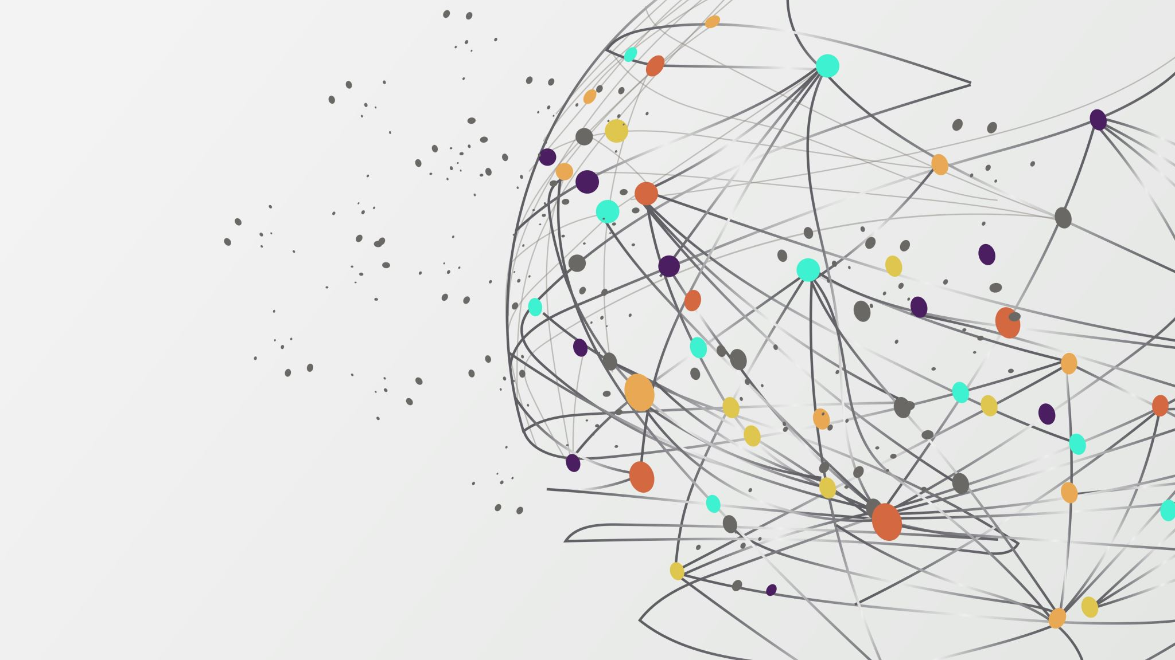
Differential Evolution

Slide 2

What is Differential Evolution ?
Population

Slide 3

What is Differential Evolution ?
Population

Slide 4
What is Differential Evolution ?
Population

Slide 5
What is Differential Evolution ?
Population

Slide 6

What is Differential Evolution ?
Population

Slide 7
What is Differential Evolution ?
Population

Slide 8
Selecting perants
Mutation
I’m alone now
Population
P1
P2
P3
P4

Slide 9




What Happens in mutation?
Mutation Rate
F
Now We represents our mutation vector

Slide 10


So that’s how we can get a new individual with new features and it named as a trail vector
Don’t care
Look what is in the sky
Thanks you you are better
Hi, you looks good and have nice features
Now lets use the cross over rate to get the better features
No
But I can be better
What?
There is nothing
Hh I got you
What is that
heeeeeeelp
CR

Slide 11
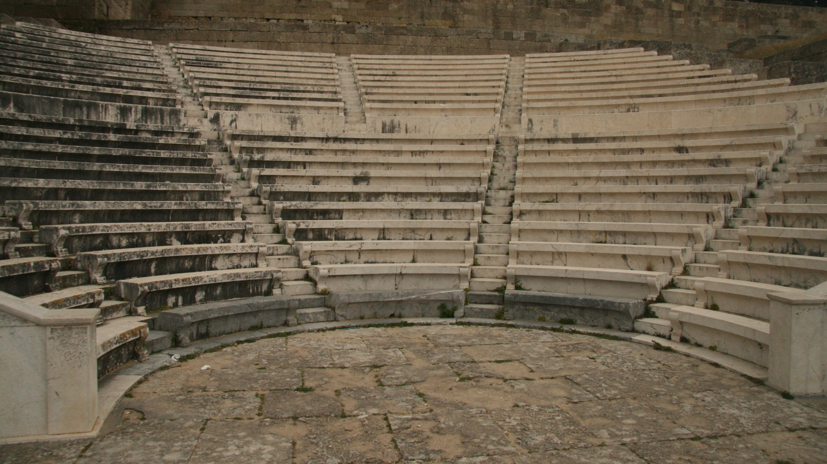
Selecting the offspring
Individual with best fitnness value would survive
Hehe boy

Slide 12
Each individual in the population should be at least once as a Target vector in each generation
Population

Slide 13
What is Differential Evolution ?
Population

Slide 14
What is Differential Evolution ?
Population

Slide 15
What is Differential Evolution ?
Population

Slide 16
What is Differential Evolution ?
Population
And so on for each individual in the population

Slide 17

We add each survived individual into a new population for the next generation
New Population

Slide 18
We repeats all the previous steps for N generation time

Slide 19

After all the generations we calculate the fitness value for all the individuals and the individual what has the lowest fitness value would be the best individual
Final Population

Slide 20
Thanks🥰

